Slide 1
NATURE
Presentation title
Powerpoint is a complete presentation graphic package it gives you everything you need to produce a professional-looking presentation

Slide 2
CONTENTS
01. Contents title
01-1. Contents title
01-2. Contents title
01-3. Contents title
02. Contents title
02-1. Contents title
02-2. Contents title
02-3. Contents title

Slide 3
04
What can we do?

Slide 4



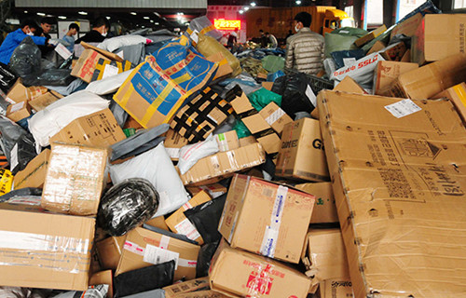
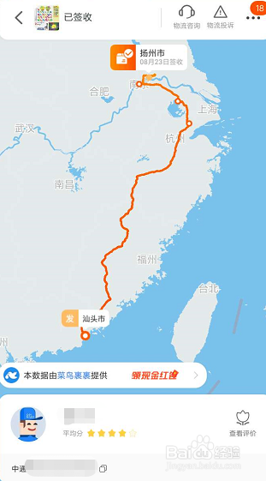
1. Reduce unnecessary online shopping
Outer packing
Transportation

Slide 5
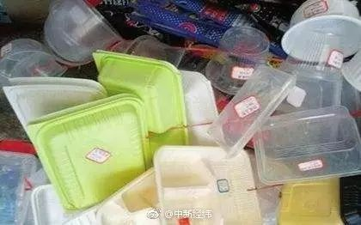
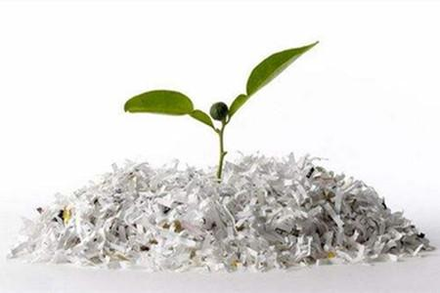
2. Reduce take-out food
White pollution

Slide 6
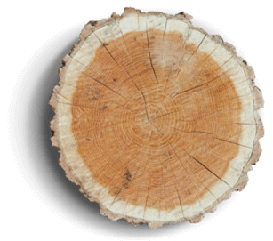
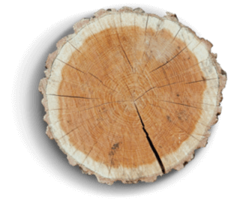
What to do
3.Use public transportation
5.Save paper
.
Bla bla bla bla bla….
4.Turn off the light

Slide 7
What to do
Awareness
Courage
.

Slide 8


With great power comes great responsibility

Slide 9
THANK YOU
Powerpoint is a complete presentation graphic package it gives you everything you need to produce a professional-looking presentation

